Slide 1
Name: R.Lingeswaran
NM id: au730321243013
Reg. No: 730321243013
Year: III
Department: B.Tech Artificial Inteeligence and Data Science
College Name: Builders Engineering College
3/21/2024
Annual Review
1

Slide 2
PROJECT TITLE
Hand Gesture Virtual Mouse
3/21/2024
Annual Review
2

Slide 3

1. Introduction to Hand Gesture Virtual Mouse.
2. System Design.
3. User Experience.
4. Technical Considerations
5. Algorithm.
6. Development And Testing.
7. Conclusion.
AGENDA
3/21/2024
Annual Review
3

Slide 4

PROBLEM STATEMENT
We have designed a system that has the power
to regulate our display screen with the assistance of our hand
gestures, which allows a pleasing interaction, and which is
free and easy to use. Our purposed Virtual Mouse can be
used to overcome problems in the real world such as
situations where there is no space to use a physical mouse
and also for persons who have problems with their hands and
are not able to control a physical mouse.
Key Challenges:
1. Gesture Recognition Accuracy.
2. User Adaptation.
3. Compatibility and Accessibility.
3/21/2024
Annual Review
4

Slide 5

PROJECT OVERVIEW
Hand Gesture Virtual Mouse – Enhanced mouse interaction
and user experience.
Software developed using Python.
Hardware Requirements – Web camera.
This can works with different multiple image processing
techniques.
Media Pipe Framework – Hand Gesture Tracking.
OpenCV library – Computer Vision.
Algorithm – Transformational Algorithm.
3/21/2024
Annual Review
5

Slide 6

WHO ARE THE END USERS?
1. General Computer Users
2. Gamers
3. People with Disabilities
4. Designers and Artists
5. Healthcare Professionals
3/21/2024
Annual Review
6

Slide 7
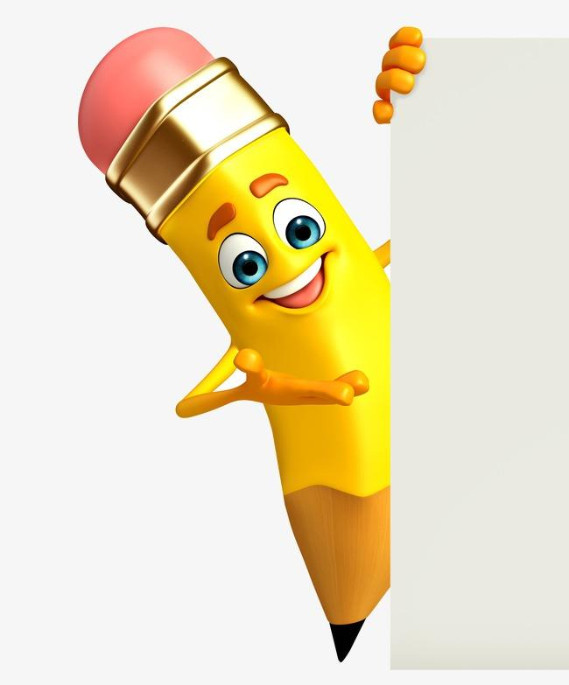
YOUR SOLUTION AND ITS VALUE PROPOSITION
Solution:
Natural and intuitive way of interactions, dynamic user experience.
Value Proposition:
Facilitate creative expression, Enhances user comfort and ergonomics.
3/21/2024
Annual Review
7

Slide 8

THE WOW IN YOUR SOLUTION
1. Contactless Interaction
2. 3D Gesture Recognition
3. Multi-Modal Input
4. Customizable Gestures
5. Cross-Platform Compatibility
3/21/2024
Annual Review
8

Slide 9
MODELLING
Relationships:
There are two main processes in the system:
Hand Detection: This process takes a Hand Image/Video frame as input and outputs the Hand Landmarks.
Gesture Recognition: This process takes the Hand Landmarks as input and outputs the Gesture Information.
One-to-Many:
A single Hand Image/Video frame can have multiple Hand Landmarks identified within it (one-to-many relationship).
One-to-One:
A set of Hand Landmarks corresponds to a single Gesture Information (one-to-one relationship).
3/21/2024
Annual Review
9

Slide 10
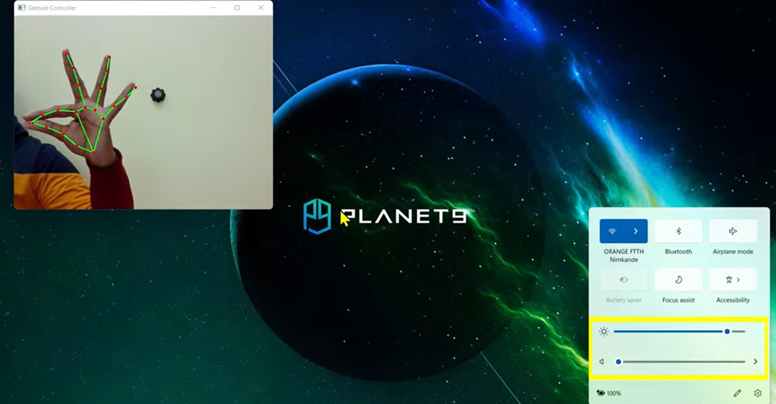
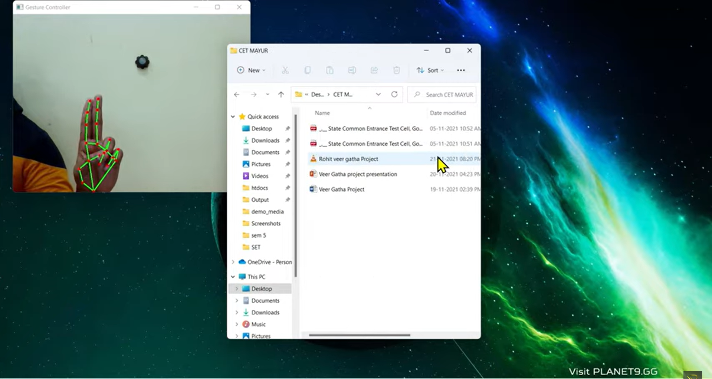
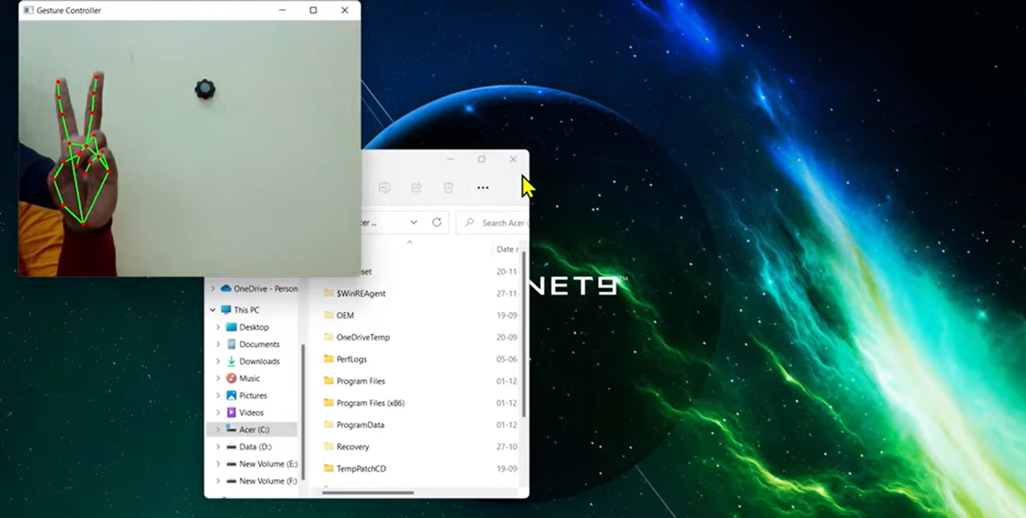
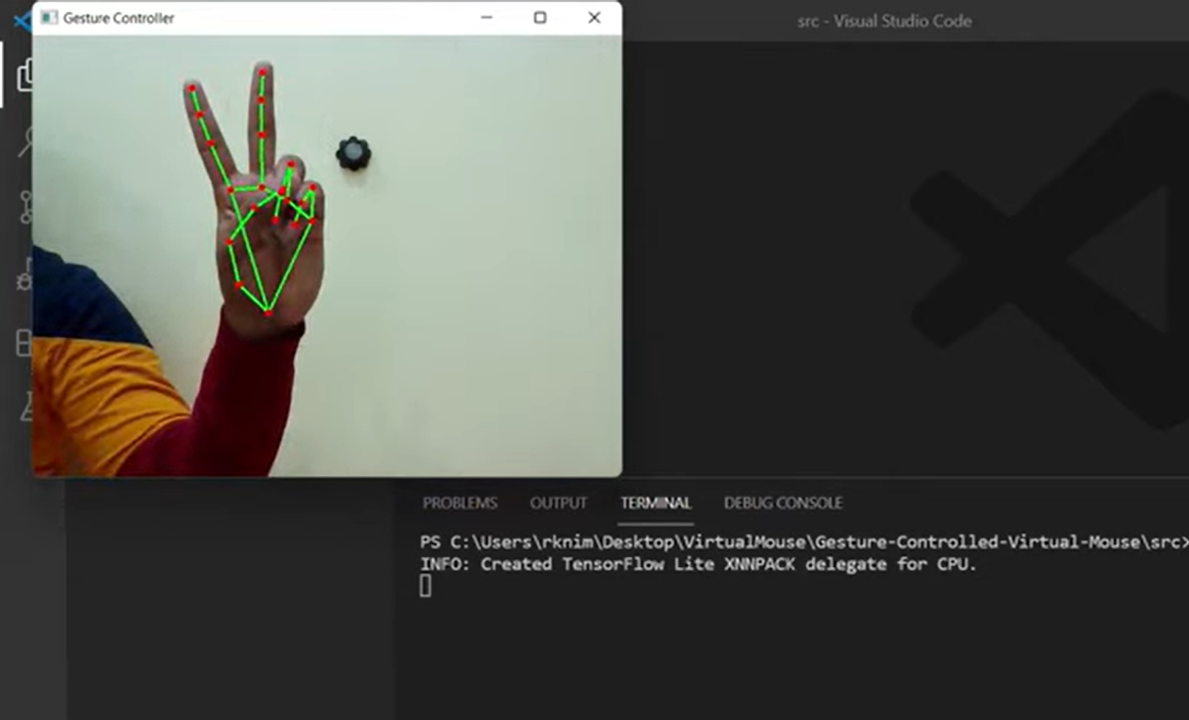
RESULTS
3/21/2024
Annual Review

